Slide 1

Chapter 2 ::
Programming Language Syntax
Programming Language Pragmatics, Fourth Edition
Michael L. Scott
Copyright © 2016 Elsevier

Slide 2
Parsing
Terminology:
  context-free grammar (CFG)
  symbols
    terminals (tokens)
    non-terminals
  production
  derivations (left-most and right-most - canonical)
  parse trees
  sentential form

Slide 3
Parsing
By analogy to RE and DFAs, a context-free grammar (CFG) is a generator for a context-free language (CFL)
  a parser is a language recognizer
There is an infinite number of grammars for every context-free language
  not all grammars are created equal, however

Slide 4
Parsing
Fortunately, there are large classes of grammars for which we can build parsers that run in linear time
– The two most important classes are called
LL and LR
LL stands for
'Left-to-right, Leftmost derivation'.
LR stands for
'Left-to-right, Rightmost derivation’

Slide 5
Parsing
LL parsers are also called 'top-down', or 'predictive' parsers & LR parsers are also called 'bottom-up', or 'shift-reduce' parsers
You commonly see LL or LR (or whatever) written with a number in parentheses after it – This number indicates how many tokens of look-ahead are required in order to parse
– Almost all real compilers use one token of look-ahead

Slide 6
Parsing
Every LL(1) grammar is also LR(1), though right recursion in production tends to require very deep stacks and complicates semantic analysis
Every deterministic CFL with the prefix property (no valid string is a prefix of another valid string) has an LR(0) grammar

Slide 7
Example: Recall of CFG
A CFG consists of
  A set of terminals T (anything only in the right side)
  A set of non-terminals N (others)
  A start symbol S (a non-terminal)
  A set of productions
id list → id id_list_tail
id list _tail → , id id_list_tail
id list_tail → ;
S → AB
A → a
B → b

Slide 8
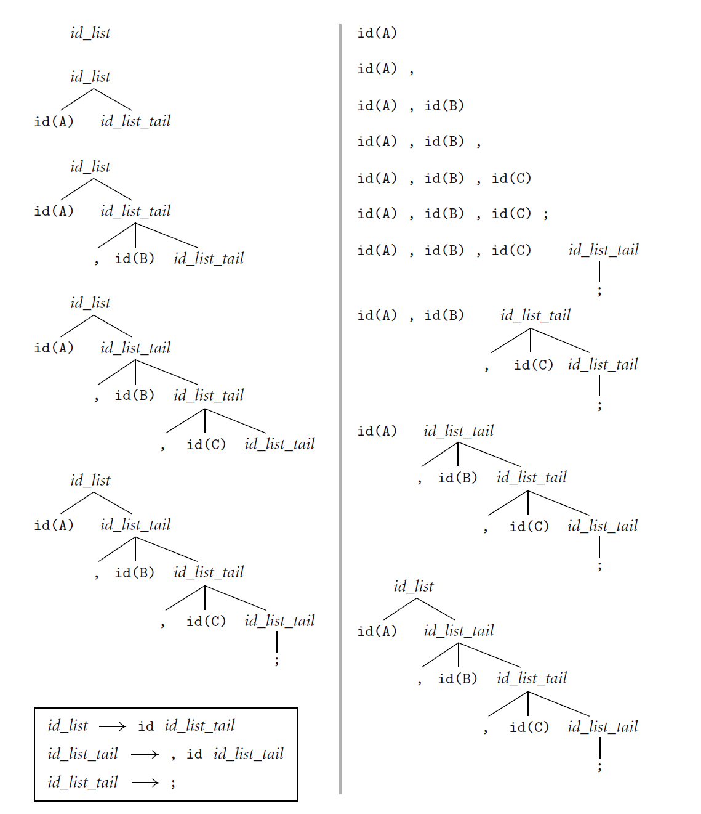
Example of LL and LR
id list → id id_list_tail
id list _tail → , id id_list_tail
id list_tail → ;

Slide 9
LL
Here is an LL(1) grammar (Fig 2.15):
program → stmt list $$$
stmt_list → stmt stmt_list
| ε
stmt → id := expr
| read id
| write expr
expr → term term_tail
term_tail → add op term term_tail
| ε

Slide 10
LL
LL(1) grammar (continued)
term → factor fact_tailt
fact_tail → mult_op fact fact_tail
| ε
factor → ( expr )
| id
| number
add_op → +
| -
mult_op → *
| /

Slide 11
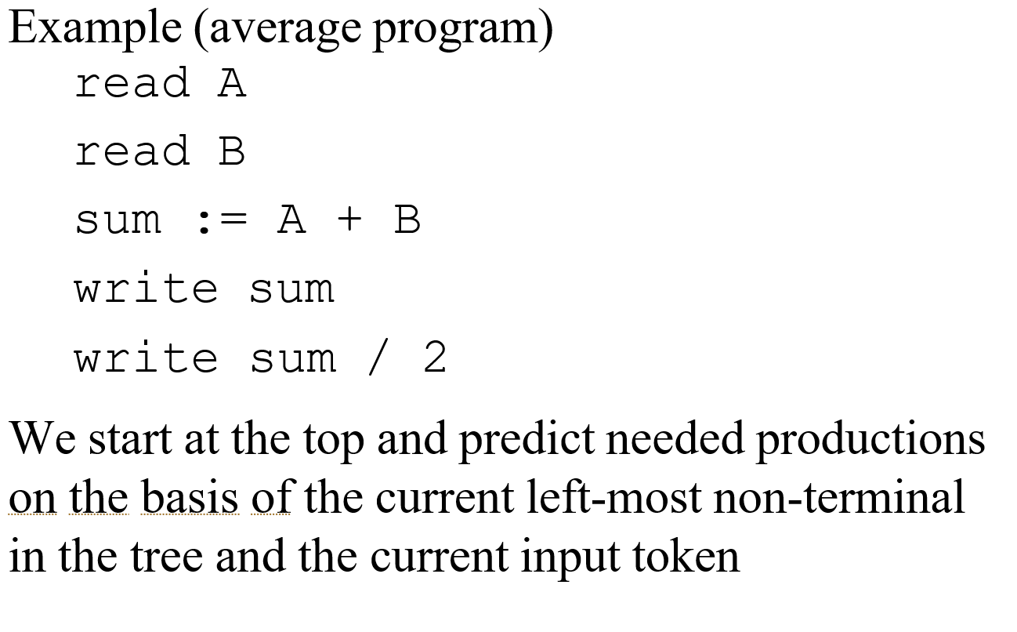
LL
How do we parse a string with this grammar?
by building the parse tree incrementally

Slide 12
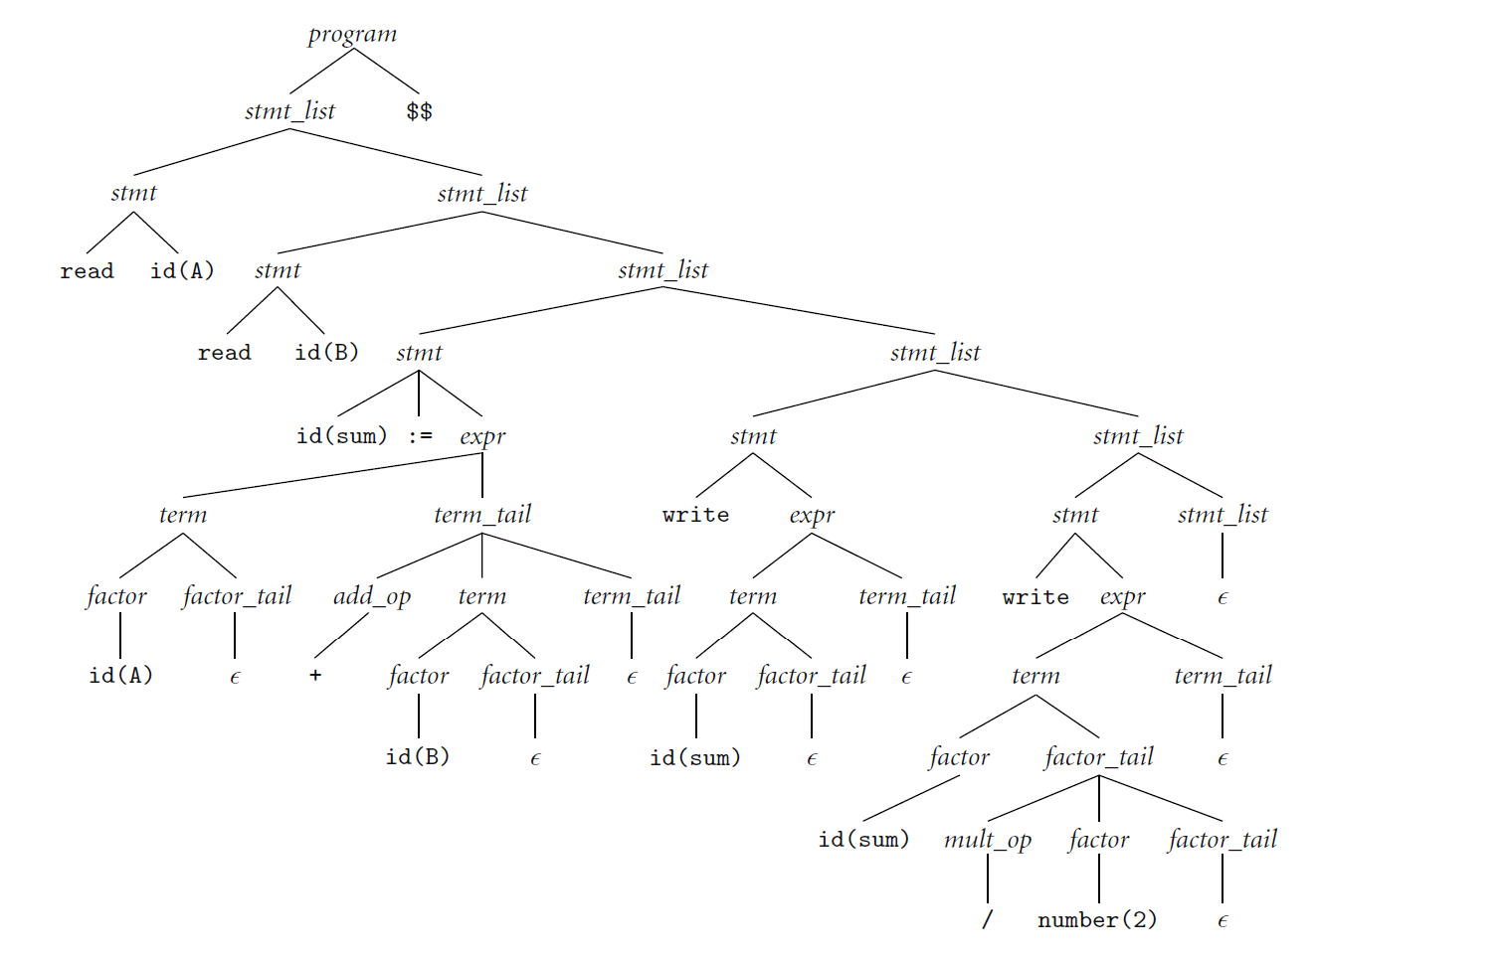
LL
Parse tree for the average program

Slide 13
LR (Bottom Up)
Revert to natural grammar:
      E -> T+E | T
      T -> int * T | int | (E)
Consider: int * int + int

Slide 14
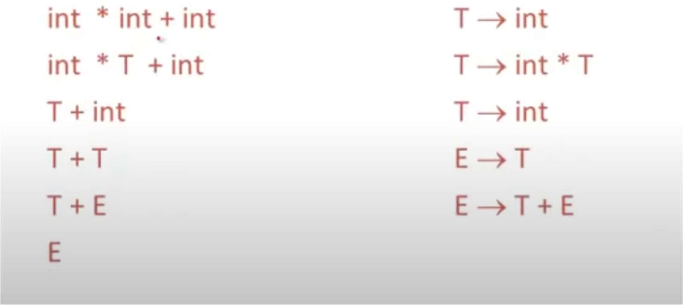
A bottom-up parser traces a right most derivation in reverse

Slide 15
Split into two substrings:
Right are yet to be examined
Left are examined non-terminals or terminals
Divided by |
Two kinds of operations:
  Shift
  Reduce
Shift: move | by one position:
ABC|xyz -> ABCx|yz
Reduce:
If A -> xy
Cbxy|ijk -> CbA|ijk

Slide 16
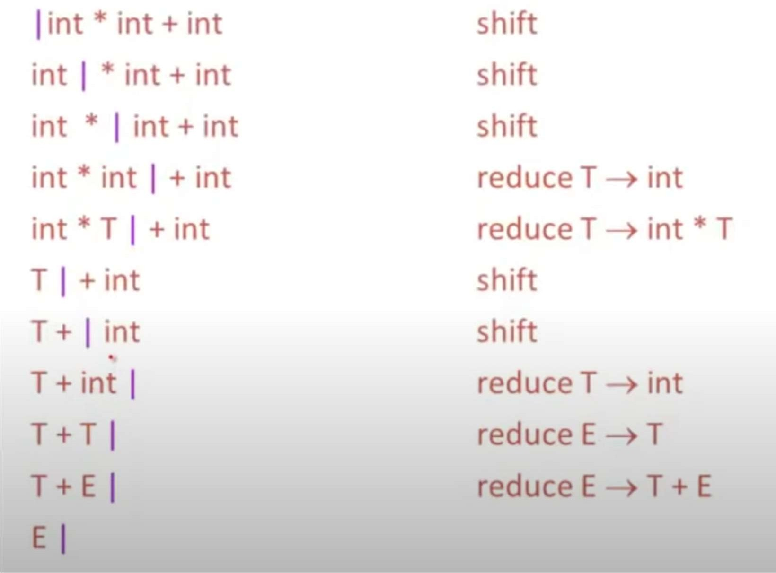
Can you draw the parser tree step by step?

Slide 17
Left substring can be implemented using stack;
Shift pushes a terminal into stack;
Reduce: pop symbols out of stack and push a non-terminal into a stack;
Can u describe the difference between LL and LR using following example?
S → AB
A → a
B → b

